Slide 1
“Teach A Level Maths”
Statistics 1
More Combinations
© Christine Crisp

Slide 2
Statistics 1
MEI/OCR
OCR
"Certain images and/or photos on this presentation are the copyrighted property of JupiterImages and are being used with permission under license. These images and/or photos may not be copied or downloaded without permission from JupiterImages"

Slide 3
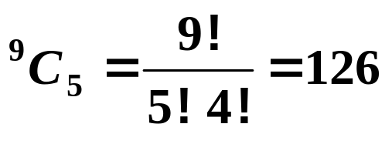
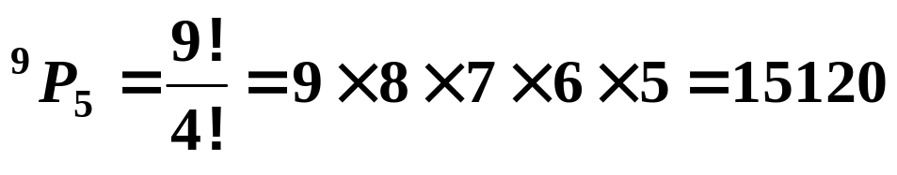
In this presentation, we are going to solve a variety of problems involving choosing.
e.g. 1. A team of 5 students is to be chosen at random from 5 girls and 4 boys. In how many ways can we choose the team?
Solution:
There are 9 students and we want to choose 5, so we have
This is many fewer than the number of arrangements of 5 which would be

Slide 4
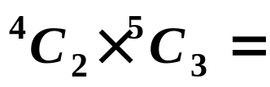


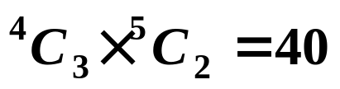
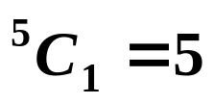
Now suppose that we don’t have a free choice of whom we choose.
e.g. 2. A team of 5 students is to be chosen at random from 5 girls and 4 boys. In how many ways can we choose the team if it must contain at least 2 boys?
Solution:
“At least 2 boys”, means we can have 2, 3 or 4 boys.
We need to consider each case separately.
(i) With 2 boys we must complete the team with 3 girls, so we get:
(ii) With 3 boys we have 2 girls:
(iii) With 4 boys we have 1 girl:
The total number of ways is 105.

Slide 5
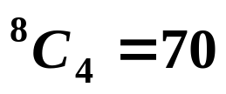
e.g. 3. In how many ways can two teams of 4 students be made from a group of 8?
Solution:
The number of ways of choosing the 1st team is
There are now only 4 left so we have no choice for the 2nd team.
Can you see why 70 isn’t the correct answer?
ANS: If we label the students A, B, C, D, E, F, G, H, one possible choice for the 1st team is ABCD. This means that EFGH are in the 2nd team.
However, one choice for the 1st team is EFGH leaving ABCD in the 2nd.
We have counted all the choices twice.
The number of ways is 35.

Slide 6
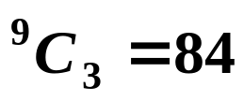
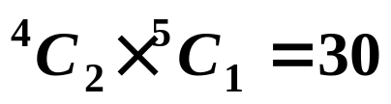
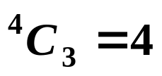



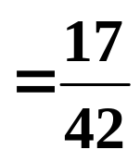
e.g. 4. From a group of 4 men and 5 women, 3 are chosen at random. What is the probability that more men than women are chosen?
Solution:
The total number of choices is
For there to be more men than women, we must have either 2 men or 3 men.
2 men and 1 woman:
3 men :
The probability of more men is

Slide 7

Exercise
1. A group of 12 maths students contain 4 who are left-handed and 8 who are right-handed.
In how many ways can 4 be chosen at random if
(a) there are no restrictions,
(b) there must be equal numbers of left-handed and right-handed students, and
(c) there must be at least 2 left-handed students.
2. Find the number of ways in which 10 people can be divided into
(a) two groups, one with 3 people and one with 7,
(b) three groups plus 1 single person where the groups have 4, 3 and 2 people.

Slide 8
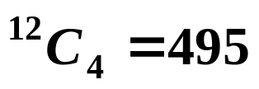
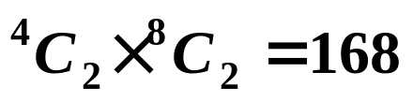
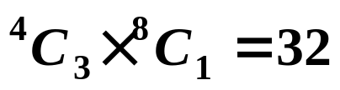

Solutions:
1. A group of 12 maths students contain 4 who are left-handed and 8 who are right-handed.
In how many ways can 4 be chosen at random if
(a) there are no restrictions,
(b) there must be equal numbers of left-handed and right-handed students, and
(c) there must be at least 2 left-handed students.
(a)
(b) We need 2 of each. So,
(c) We need either 2, 3 or 4 left-handers ( part (b) gives the answer for 2 ):
3 left and 1 right:
4 left ( so all of them ):
There are 201 ways of choosing at least 2 left-handers.

Slide 9
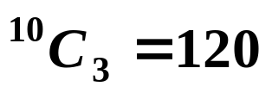
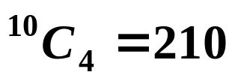
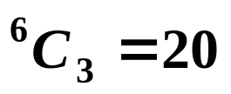
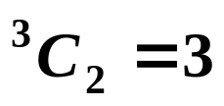

Solutions:
2. Find the number of ways in which 10 people can be divided into
(a) two groups, one with 3 people and one with 7,
(b) three groups plus 1 single person where the groups have 4, 3 and 2 people.
Solution:
(a) Choose 3 people:
There are now only 7 left, so they form the other group. ( Each group doesn’t appear twice because they are different sizes. )
(b) Choose 4 people:
Choose 3 from the rest:
Choose 2 from the rest:
One person is now left.
The number of ways is

Slide 10


Slide 11
The following slides contain repeats of information on earlier slides, shown without colour, so that they can be printed and photocopied.
For most purposes the slides can be printed as “Handouts” with up to 6 slides per sheet.

Slide 12
e.g. 1. A team of 5 students is to be chosen at random from 5 girls and 4 boys. In how many ways can we choose the team?
Solution:
There are 9 students and we want to choose 5, so we have
This is many fewer than the number of arrangements of 5 which would be
Now suppose that we don’t have a free choice of whom we choose.

Slide 13
e.g. 2. A team of 5 students is to be chosen at random from 5 girls and 4 boys. In how many ways can we choose the team if it must contain at least 2 boys?
Solution:
“At least 2 boys”, means we can have 2, 3 or 4 boys.
We need to consider each case separately.
(i) With 2 boys we must complete the team with 3 girls, so we get:
(ii) With 3 boys we have 2 girls:
(iii) With 4 boys we have 1 girl:
The total number of ways is 105.

Slide 14
e.g. 3. In how many ways can two teams of 4 students be made from a group of 8?
Solution:
The number of ways of choosing the 1st team is
There are now only 4 left so we have no choice for the 2nd team.
However, if we label the students A, B, C, D, E, F, G, H, one possible choice for the 1st team is ABCD. This means that EFGH are in the 2nd team.
Also, one choice for the 1st team is EFGH leaving ABCD in the 2nd.
We have counted all the choices twice.
The number of ways is 35.

Slide 15
e.g. 4. From a group of 4 men and 5 women, 3 are chosen at random. What is the probability that more men than women are chosen?
Solution:
The total number of choices is
For there to be more men than women, we must have either 2 men or 3 men.
2 men and 1 woman:
3 men :
The probability of more men is

